Slide 1

SCRUM- AGILE APPROACH
By
Neelima Patnaik
12/12/20

Slide 2
Agenda
What is SDLC?
What is AGILE?
What is Scrum?
Roles in Scrum Team

Slide 3
Software Development Life Cycle or SDLC
The SDLC is a methodology that defines the steps of the software development project and there are several stages. Each stage is SDLC produces deliverables and that is required to begin the next in the process.

Slide 4
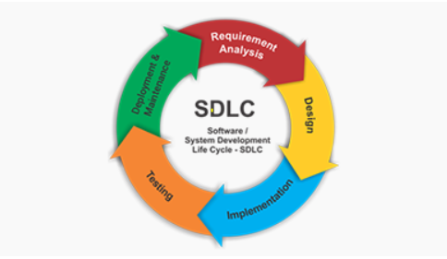
Stages of SDLC

Slide 5
SDLC Phases
During the agile software development life cycle, six specific phases dictate where the project is at any point in time, and what comes next in terms of evolution. The various SDLC phases are requirement gathering and analysis, design, implementation or coding, testing, deployment, and support.

Slide 6
What is Agile?
Agile is an umbrella term over several project management approaches that are characterized by their ability to allow project teams to respond to changing requirements and priorities by using incremental work packages.

Slide 7
What is Scrum?
Scrum is a simple framework to boost productivity and deliver the products that will delight the customers
It does this by breaking complex into smaller components parts
Team focus on tackling one peace at a time and the team revaluate what direction that product will take and what process is most efficient to accomplish that.
Scrum allows the team to adapt and inspect more quickly

Slide 8
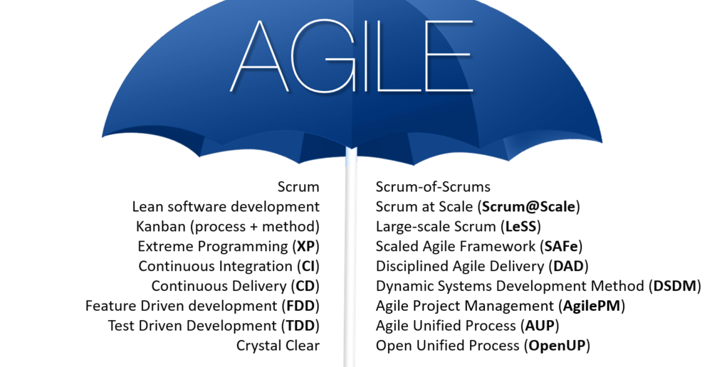

Slide 9
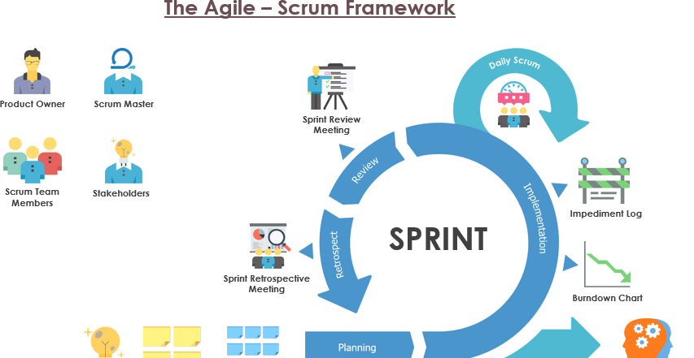

Slide 10
Roles of the Agile – Scrum Team
The Scrum Master, Product owner and Development team are most important roles in the Scrum.

Slide 11
The Scrum Team
The Scrum Master: Scrum Masters are Scrum expert to the team. They coach developers and product owners and the business on the scrum process.
Scrum masters are servant-leader for the scrum team.
The Product Owner: Product owners are champions for the product. Their main job is to product vision to life and the constant pulse on the market and the customer.
The Development Team: Development team has some characteristics such as self-organizing and cross-functional. The team role in a scrum is also known as a development team. The most important task for the team role is to work as a whole not as an individual.

Slide 12
What is the process would have been different with a waterfall development approach
1. Waterfall is a structured software development methodology whereas Agile is known for flexibility
2.Waterfall is a Linear sequential Life cycle model whereas agile is continuous iteration which helps in the project to move forward towards progress
3. Agile is the best for the project because it follows an incremental approach
4.There are chances of risk in waterfall methodology because the testing phase comes in the build phase. In this case, Agile is proved the best to perform testing concurrently with software development.

Slide 13
Factors to consider Agile development
1. Customer Satisfaction
2. Adaptive to the customer needs
3. Minimal Disruption
4. Leadership
5. Organization design

Slide 14
References:
https://study.com/academy/lesson/agile-methodology-types-examples.html
https://www.knowledgehut.com/blog/agile/agile-transformation-factors
https://deepgnosis.me/agile-an-umbrella-view/

